Slide 1
Agrégation spatiotemporelle pour la visualisation de traces d’exécution
Damien Dosimont
Advisor: Guillaume Huard – Co-advisor: Jean-Marc Vincent

Slide 2

Context

Slide 3


Systems and applications become more and more complex…
…to analyze

Slide 4





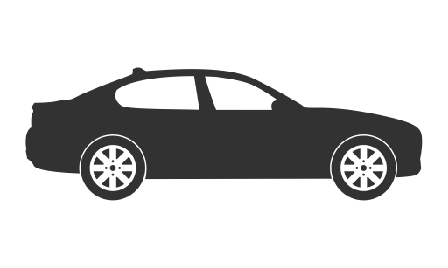







Embedded systems
Deep software
stack
Real time
f(x)/s
Quantity of
events/s
Not developer
friendly
Step-by-step debugger (ex: GDB)

Slide 5



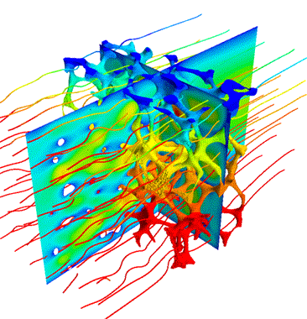













Parallel systems
Indeterminism
Middlewares
f(x)/s
Complex
& Distributed
Artchitecture
Quantity of
events/s
Resource
sharing
Step-by-step debugger (ex: GDB)

Slide 6





Trace Analysis
Complex system/application
Collect information about the execution and save them in a file
Process trace data
Statistics
A
Automatic approach
Analyze the content
Visualization

Slide 7

Main thread

Slide 8


TS Record use case
Streaming
Record
TV program
Set-top box
Hard drive

Slide 9

May the quality of service be with you

Slide 10

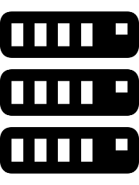
TS Record use case
IP buffers
Memory
Hard drive
IP packets
sys_write()
flush-8:0
every
100 ms
Disk cache
every
5000 ms
230 KB

Slide 11
How to analyze this application?
?

Slide 12
How we imagine analyzing the application
Space-time diagram inspired by Gantt Chart

Slide 13
How we imagine analyzing the application

Slide 14
How we imagine analyzing the application
Function green(){
…
}
Function red(){
…
}
Function purple(){
…
}

Slide 15
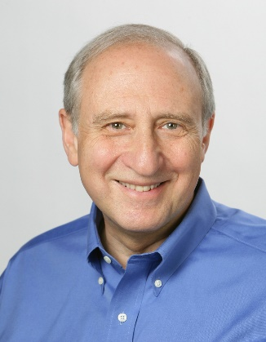




Shneiderman’s mantra
Overview first,
Zoom
and
Filter,
then
Details-on-demand
}

Slide 16
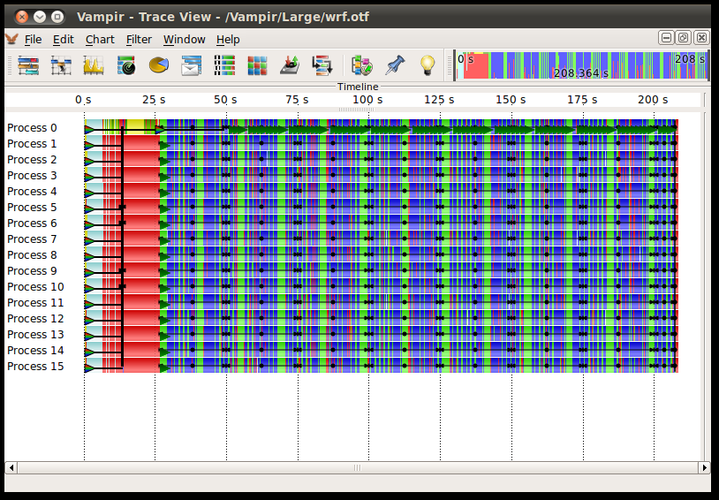
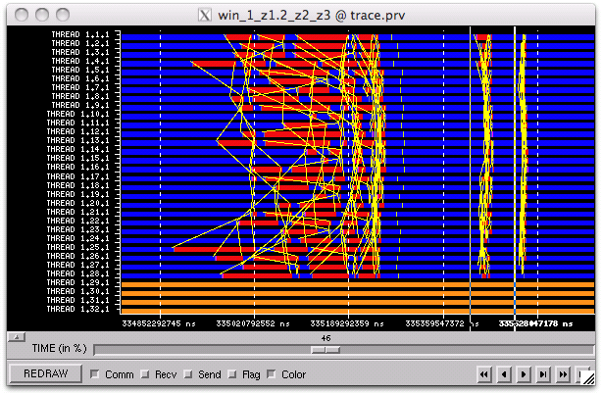
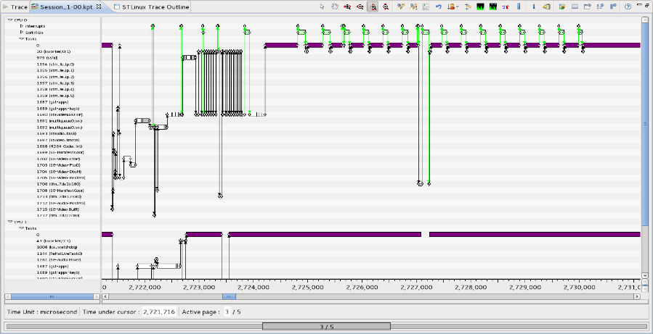
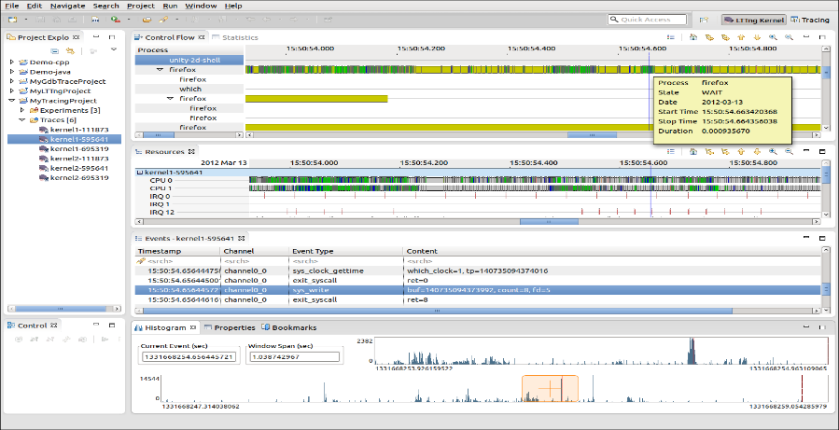
Examples of tools using Gantt chart
Vampir
Paraver
T-Charts
Trace Compass

Slide 17





What about scalability?

Slide 19

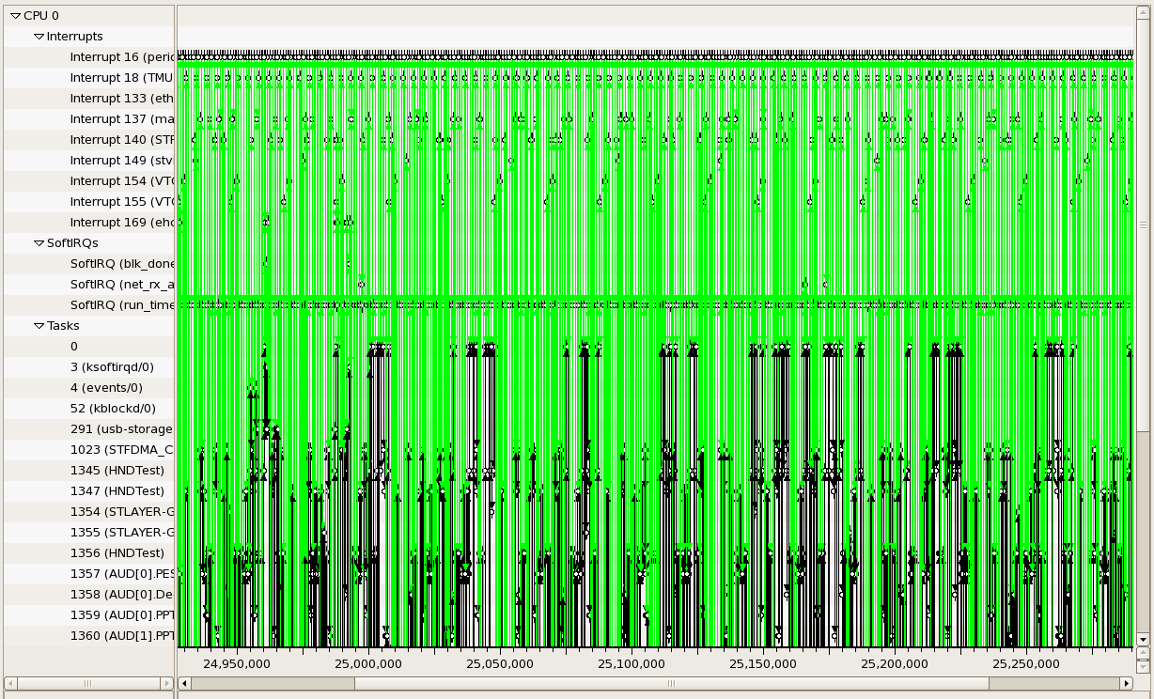
Visualization support

Slide 20
Visualization support
+
=
≈
6 graphical objects
4 available pixels
Fitting graphical
objects with pixels
Final representation:
-some objects are lost
-proportions are not kept

Slide 21
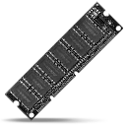


Performance
Memory Limitations
Hardware performance
Algorithmic complexity
Libraries, components, languages, etc.

Slide 22

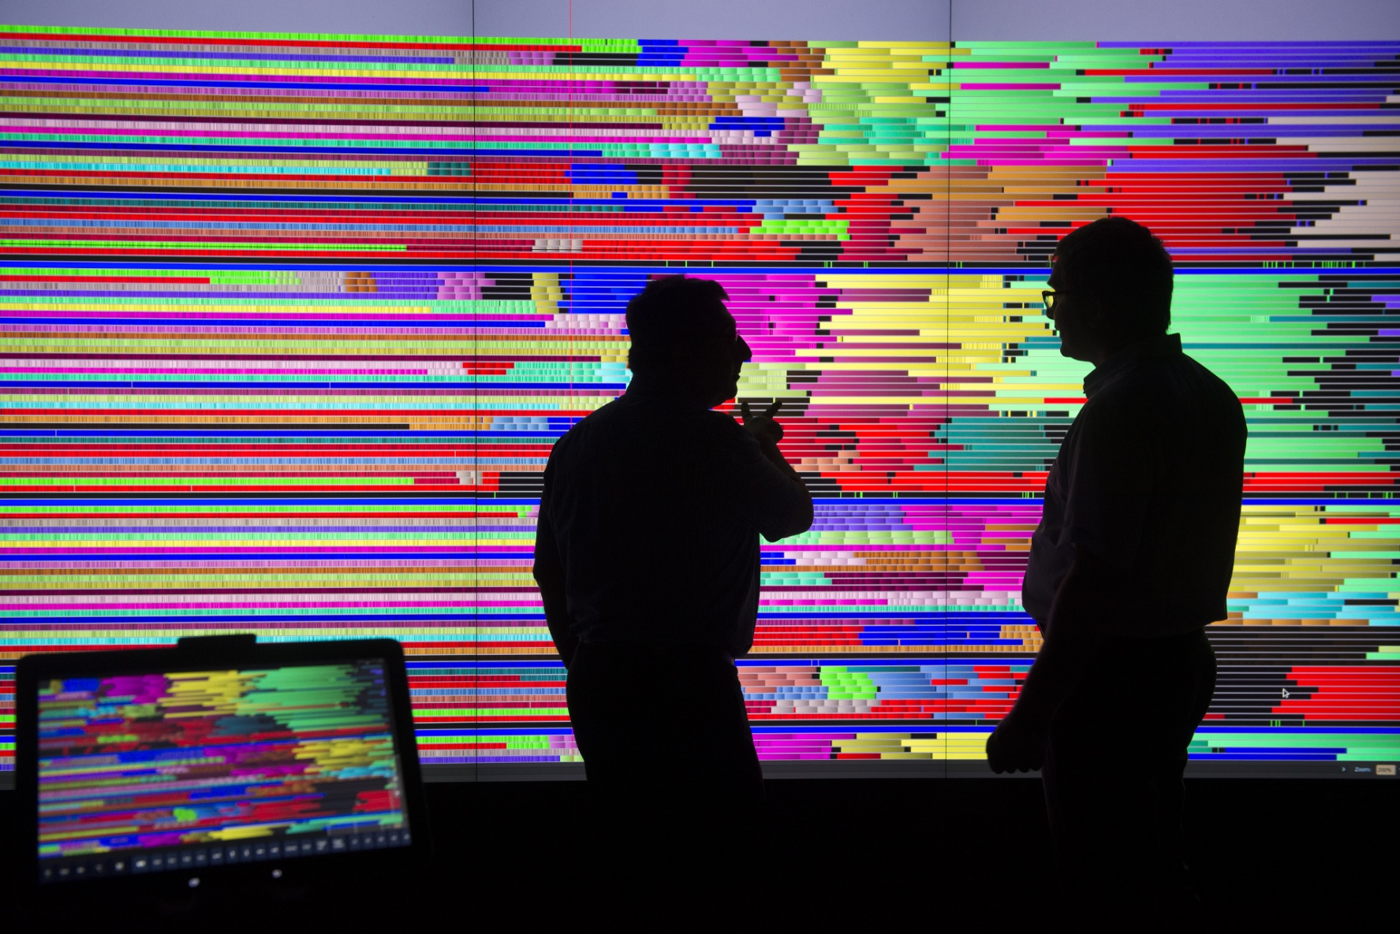
User

Slide 23

Shneiderman’s mantra
Overview first,
Zoom
and
Filter,
then
Details-on-demand
}

Slide 24

Proposal

Slide 25
Fulfill Shneiderman’s with Ocelotl

Slide 26
Overview
Temporal
Spatiotemporal

Slide 27
Explain

Slide 28
Lamarche-Perrin’s Method

Slide 29



Multi agent system analysis
Analytic approach
Complex
System
Microscopic
Obervation
Microscopic
Representation
Analyst
Complexity
Quantity of data

Slide 30


Multi agent system analysis
Systemic approach
Microscopic
Representation
Abstraction
Complex
System
Microscopic
Obervation
Macroscopic
Representation
Analyst

Slide 31

Lamarche-Perrin’s method
Microscopic
Representation
Abstraction
Complex
System
Microscopic
Obervation
Macroscopic
Representation
Method based on Partition+Aggregation
Analyst

Slide 32
From the partition to the interpretation
5
5
1
15
5
9
5
1
1
1
2
6
3
4
3
Partition
Aggregation
(sum)
Redistribution
(uniform)
Visualization

Slide 33
How to choose the « good » partitions?
?

Slide 34
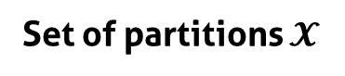

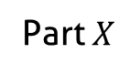
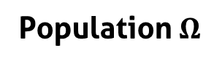
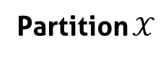
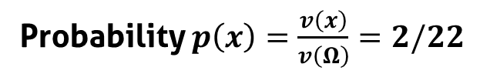
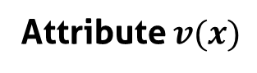
Notations
Part $X$
5
Population $Ω$
1
5
9
1
Individuals $x$
9
1
1
4
2
Attribute $v(x)$
2
4
Probability $p\left(x\right)=\frac{v\left(x\right)}{v\left(Ω\right)}=2/22$
Partition $𝒳$
Set of partitions $𝓧$
5
5
1
5
5
5
1
1
9
1
1
9
9
1
9
9
1
1
1
1
2
2
2
2
4
…
4
4
4
4
2

Slide 35
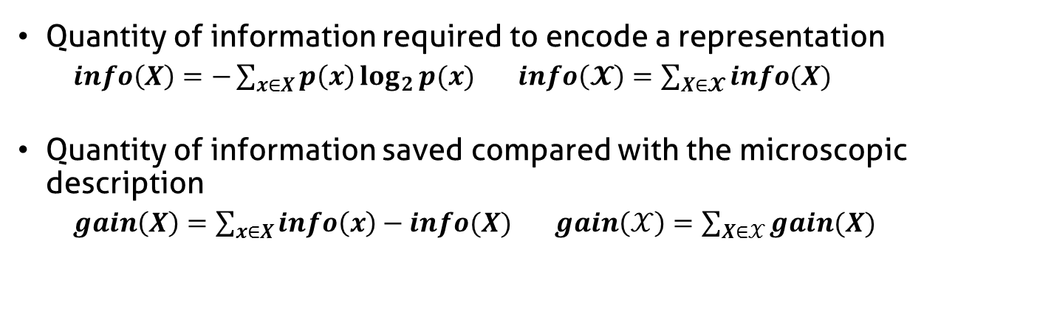
Complexity reduction
Quantity of information required to encode a representation
$info\left(X\right)=−\sum_{x∈X}{p\left(x\right)\log_{2}{p(x)}}$ $info\left(𝓧\right)=\sum_{X∈𝓧}{info(X)}$
Quantity of information saved compared with the microscopic description
$gain\left(X\right)=\sum_{x∈X}{info\left(x\right)−info(X)}$ $gain\left(𝒳\right)=\sum_{X∈𝒳}{gain(X)}$
Complexity reduction
5
5
5
1
1
1
1
1
1
9
9
9
2
2
2
4
4
4
Number of elements (aggregates)

Slide 36
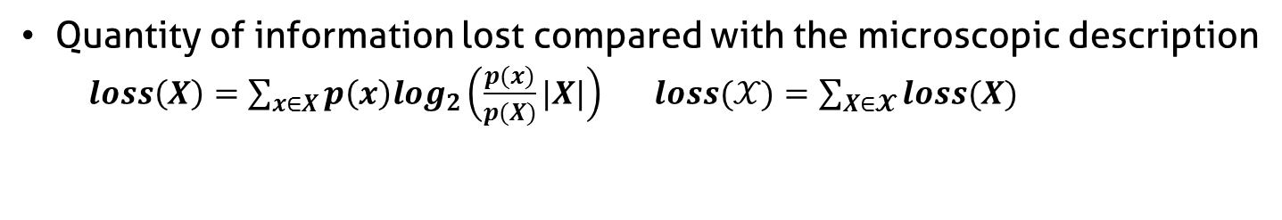
Information Loss
Quantity of information lost compared with the microscopic description
$loss\left(X\right)=\sum_{x∈X}{p\left(x\right)log_{2}\left(\frac{p(x)}{p(X)}|X|\right)}$ $loss(𝒳)=\sum_{X∈𝓧}{loss(X)}$
5
High
Information Loss
4
1
1
4
4
9
4
4
4
4
4
5
Low
Information Loss
4
4
4
4
4
4
4
4
4
3
4

Slide 37
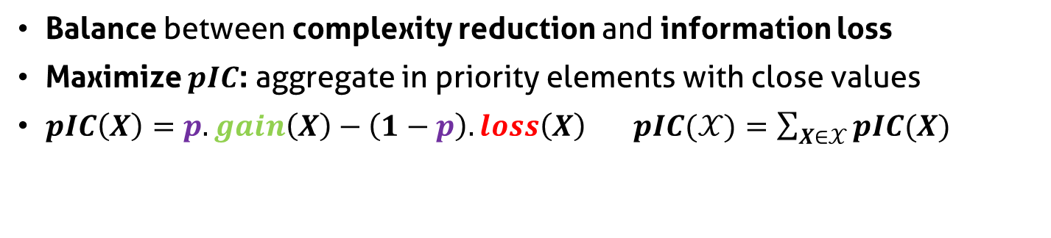
Parametrized Information Criterion
Balance between complexity reduction and information loss
Maximize $pIC$: aggregate in priority elements with close values
$pIC\left(X\right)=p.gain\left(X\right)−\left(1−p\right).loss\left(X\right)$ $pIC(𝒳)=\sum_{X∈𝒳}{pIC(X)}$
Parameter p
Complexity reduction
5
5
5
1
1
1
1
1
1
9
9
9
2
2
2
4
4
4
Information loss

Slide 38
Constrain the set of partitions
Reduce set of partition size
Decrease algorithmic complexity
Bring coherence with syntaxic and semantic characteristics of the system

Slide 39
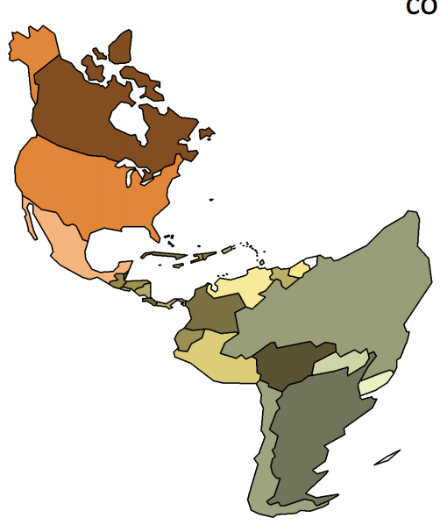
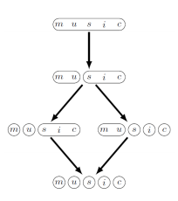

Ex: Hierarchical aggregation
Spatial analysis
Admissible partitions

Slide 40
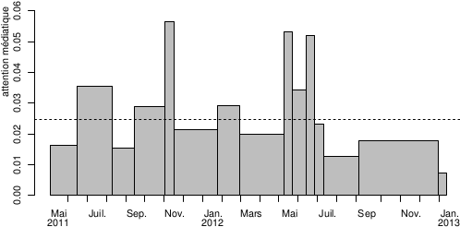
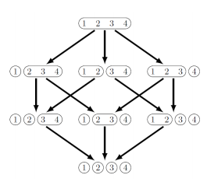
Ex: Ordered set aggregation
Temporal analysis
Admissible partitions

Slide 41

Temporal Analysis

Slide 42
Interest of Temporal Analysis

Slide 43
How to adapt LP method to trace analysis
Microscopic
Representation
Abstraction
Complex
System
Microscopic
Obervation
Macroscopic
Representation
Analyst

Slide 44

How to adapt LP method to trace analysis
Microscopic
Representation
Abstraction
Trace
Microscopic
Obervation
Macroscopic
Representation
Analyst

Slide 45





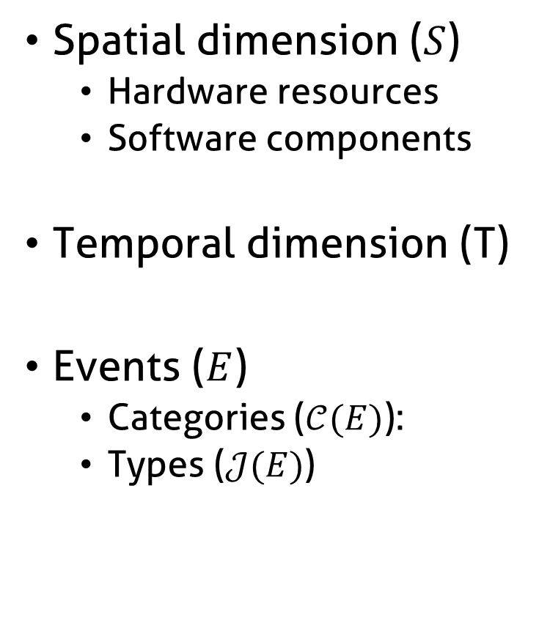
Information contained in traces
Spatial dimension ($S$)
Hardware resources
Software components
Temporal dimension (T)
Events ($E$)
Categories ($𝒞(E)$):
Types ($𝒥(E)$)

Slide 46
How to adapt LP method to trace analysis
Microscopic
Representation
Abstraction
Trace
Microscopic
Obervation
Macroscopic
Representation
Analyst

Slide 47






How to adapt LP method to trace analysis?
?
?
Trace =
Nanoscopic
Model
Microscopic
Model
Qualities
Partition
Abstraction
Visualization

Slide 48
Build a microscopic model from the trace
?
?
Trace =
Nanoscopic
Model
Microscopic
Model
Qualities
Partition
Abstraction
Visualization

Slide 49
Build a microscopic model from the trace
Trace =
Nanoscopic
Model
Discretization
Microscopic
Model
Time continuous
Space discrete
Event types discrete
Time discrete
Space discrete
Event types discrete

Slide 50

Information contained in traces
Spatial dimension ($S$)
Hardware resources
Software components
Temporal dimension (T)
Events ($E$)
Categories ($𝒞(E)$):
Types ($𝒥(E)$)

Slide 51

Microscopic model structure
Function $M^{t}$ from $S×T×𝒥(E)$to $ℝ$+
J5
J4
J3
Event types
J2
J1
s1
Space
s2
s3
t1
t2
t3
t4
t5
Time (discrete)

Slide 52
Fill the microscopic model
Time (continuous)
Sum of state durations
s1
s2
Time slice
Space
s3
d1 + d2 + p1*d3
s1
d1+d2+p1*d3
s2
Space
s3
t1
t2
t3
t4
t5
Time (discrete)

Slide 53
Aggregate the microscopic model
Original algorithm:
scalar values
t1
t2
t3
t4
t5
Time (discrete)
Objective:
multidimensional
values
t1
t2
t3
t4
t5
Time (discrete)

Slide 54
Adapt the quality computation
?
Trace =
Nanoscopic
Model
Microscopic
Model
Qualities
Partition
Abstraction
Visualization

Slide 55
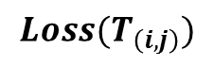
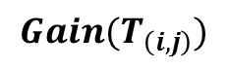
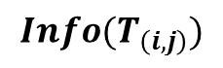
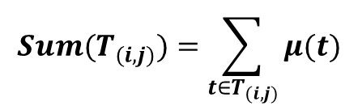
Quality computation of monodimensional values
Monodimensional microscopic model
Intermediate measures
$$Sum(T_{(i,j)})=\sum_{{t∈T}_{(i,j)}}{μ(t)}$$
Time (discrete)
Data structure of time intervals T(i,j)
$$Info(T_{\left(i,j\right)})$$
Quality measures
i
$$Gain(T_{\left(i,j\right)})$$
$$Loss(T_{\left(i,j\right)})$$
j

Slide 56
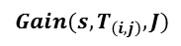
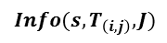
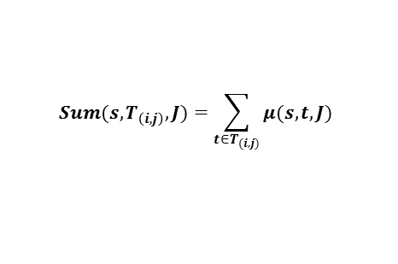
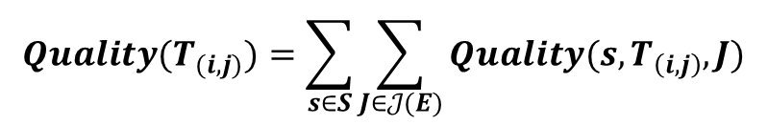
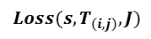
Quality computation of multidimensional values
Intermediate measures
$$Sum(s,T_{\left(i,j\right)},J)=\sum_{{t∈T}_{(i,j)}}{μ(s,t,J)}$$
Jr
Jb
s1
$$Info({s,T}_{\left(i,j\right)},J)$$
Quality measures
s2
$$Gain(s,T_{\left(i,j\right)},J)$$
$$Loss(s,T_{\left(i,j\right)},J)$$
=
+
+
+
$$Quality(T_{(i,j)})=\sum_{s∈S}{\sum_{J∈𝒥(E)}{Quality(s,T_{\left(i,j\right)},J)}}$$

Slide 57
Best cut computation
?
Trace =
Nanoscopic
Model
Microscopic
Model
Qualities
Partition
Abstraction
Visualization

Slide 58
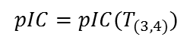
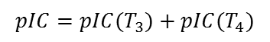
Best cut computation
Compute, compare, and select pIC for time intervals
pIC=p*gain-(1-p)*loss
User provides p
Already
computed
Ex: 4 time slices
$$pIC=pIC(T_{3})+pIC(T_{4})$$
Possible cuts: Cut[i]
i=4
Cut[4]=4
$$pIC=pIC(T_{(3,4)})$$
i=3
or
Cut[3]=3 or 4
i=2
or
or
Cut[2]=2, 3 or 4
or
or
i=1
Cut[1]=1, 2, 3 or 4
or

Slide 59

Rebuild the best partition
Example
Cut[1]?
Cut[1]=2
Cut[2+1]?
Cut[3]=3
Cut[3+1]?
Cut[4]=4
Best Partition

Slide 60
Interpret the aggregation result
?
Trace =
Nanoscopic
Model
Microscopic
Model
Qualities
Partition
Abstraction
Visualization

Slide 61
Aggregate and redistribute the values
Microscopic model
Partition
?
Aggregation (sum)
!
Uniform redistribution

Slide 62
Visualize the trace abstraction
?
Trace =
Nanoscopic
Model
Microscopic
Model
Qualities
Partition
Abstraction
Visualization

Slide 63
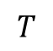
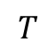
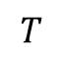
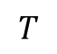
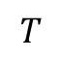
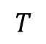
Visualize the trace abstraction
Bar chart
$$T$$
Colored
partition
$$T$$
$$T$$
Stacked bar
chart
$$T$$
$$T$$
Mode
$$T$$
Spatial aggregation
Aggregation of event types

Slide 64
Stacked bar chart visual aggregation
minimal height
blue + orange event type
total height < minimal height
blue event type
height < minimal height
blue + orange event type
individual height < minimal height
total height > minimal height
Decrease available height

Slide 65
Example of analyses

Slide 66
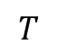
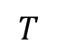
Main thread
Parameter p increasing
$$T$$
$$T$$

Slide 67
TS Record analysis

Slide 68
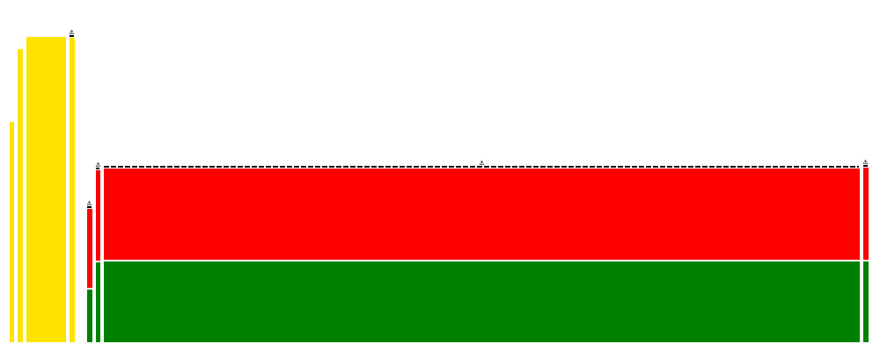
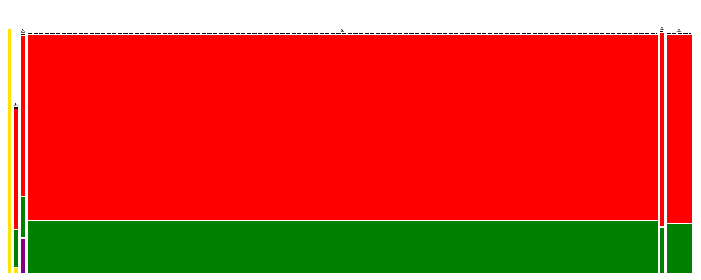
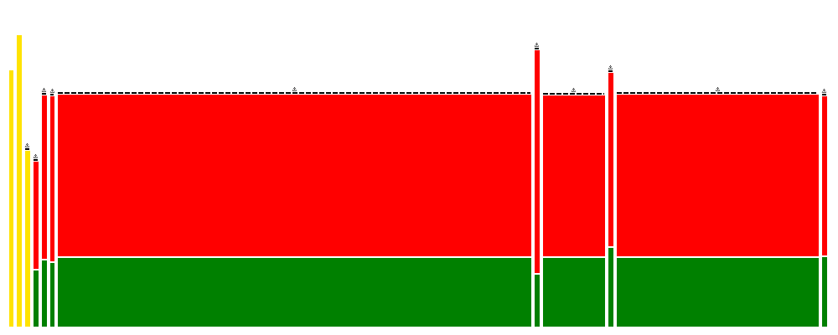
Conjugate Gradient running on G5K

Slide 69

We need some space!

Slide 70


Spatiotemporal Analysis
+

Slide 71




Hardware/software hierarchy
Hardware components
Site
Clusters
Nodes
Cores
Threads
Software components

Slide 72
Build a microscopic model from the trace
Trace =
Nanoscopic
Model
Discretization
+ Hierarchization
Microscopic
Model
Time continuous
Space flat
Event types discrete
Time discrete
Space hierarchized
Event types discrete

Slide 73

Microscopic model structure
Function $M^{st}$ from $S×T×𝒥(E)$to $ℝ$+
Event types
J3
J2
J1
s1
s2
Space
s3
s4
s5
t1
t2
t3
t4
t5
Time (discrete)

Slide 74
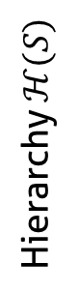
Hierarchize the spatial dimension
Event types
J3
J2
J1
s1
Sa
s2
Hierarchy $ℋ(S)$
s3
S
s4
Sb
s5
t1
t2
t3
t4
t5
Time (discrete)

Slide 75
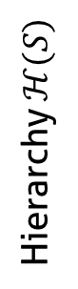
Aggregate the microscopic model
s1
Sa
s2
Hierarchy $ℋ(S)$
s3
S
s4
Sb
s5
t1
t2
t3
t4
t5
Time (discrete)

Slide 76
Forbidden Aggregates
s1
Sa
s2
Hierarchy $ℋ(S)$
s3
S
s4
Sb
s5
t1
t2
t3
t4
t5
Time (discrete)

Slide 77
Visualize the abstraction

Slide 78
Visual aggregation
Decrease available height

Slide 79
Example of analyses

Slide 80
Lower Upper Gauss Siedel on G5K

Slide 81
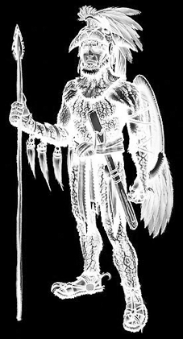
Implementation: Ocelotl Analysis Tool

Slide 82

Presentation

Slide 83
Ocelotl Architecture

Slide 84


Framesoc

Slide 85
Shneiderman’s mantra: Overview

Slide 86
Shneiderman’s mantra: Zoom

Slide 87
Shneiderman’s mantra: Filter

Slide 88

Shneiderman’s mantra: Details on demand

Slide 89

Shneiderman’s mantra: Details on demand

Slide 90

Shneiderman’s mantra: Details on demand

Slide 91



Performance
! Query optimization
Microscopic
model
Qualities
Quality curves
Abstraction
Trace (DB)
Visualization
! Microscopic Model
Cache

Slide 92
Query Optimization

Slide 93
Cache Performance

Slide 94
Temporal Aggregation

Slide 95
Spatiotemporal Aggregation

Slide 96
In practical…
Real traces:
Up to 12 GB (218 million of events)
Temporal: ~1500 resources
Spatiotemporal: ~700 resources
Synthetic traces:
Up to 68 GB (2 billion of events)
Temporal: ~ 100 000 resources, 10 event types, 100 time slices
Spatiotemporal: ~10 000 resources, 10 event types, 30 time slices

Slide 97
Conclusion

Slide 98
Publications
International Conferences
A Spatiotemporal Data Aggregation Technique for Performance Analysis of Large-scale Execution Traces. Damien Dosimont, Robin Lamarche-Perrin, Lucas Mello Schorr, Guillaume Huard, Jean-Marc Vincent, IEEE Cluster 2014, pages 149-157, Madrid, September 2014.
Efficient Analysis Methodology For Huge Application Traces. Damien Dosimont, Generoso Pagano, Guillaume Huard, Vania Marangozova-Martin, Jean-Marc Vincent, 2014 International Conference on High Performance Computing & Simulation, pages 951-958, Bologna, June 2014.
Trace Management and Analysis for Embedded Systems. Generoso Pagano, Damien Dosimont, Guillaume Huard, Vania Marangozova-Martin, Jean-Marc Vincent, 2013 IEEE 7th International Symposium on Embedded Multicore Socs (MCSoC), pages 119-122, Tokyo, September 2013.
Workshops
Ocelotl: Large Trace Overviews Based on Multidimensional Data Aggregation. Damien Dosimont, Youenn Corre, Lucas Mello Schnorr, Guillaume Huard, Jean-Marc Vincent, 8th International Parallel Tools Workshop (IPTW’14), Stuttgart, October 2014.
Agrégation temporelle pour l’analyse de traces volumineuses. Damien Dosimont, Guillaume Huard, Jean-Marc Vincent, 10ème Atelier en Evaluation de Performances, Sophia Antipolis, June 2014.
La visualisation de traces, support à l’analyse, déverminage et optimisation d’applications de calcul haute performance. Damien Dosimont, Guillaume Huard, Jean-Marc Vincent, Atelier Visualisation d’informations, interaction et fouille de données (VIF) de la 13e Conférence Francophone sur l’Extraction et la Gestion des Connaissances (EGC’2013), pages 55-66, Toulouse, January 2013.

Slide 99



Thanks

Slide 100
Backup

Slide 101
Main thread: a recording application
Streaming
Record
TV program
Set-top box
Hard drive
TS Record use case

Slide 102
How to adapt LP method to spatiotemporal analysis?
?
?
?
?
?
Trace =
Nanoscopic
Model
Microscopic
Model
Qualities
Partition
Abstraction
Visualization

Slide 103
Microscopic model building
?
?
?
?
?
Trace =
Nanoscopic
Model
Microscopic
Model
Qualities
Partition
Abstraction
Visualization

Slide 104
Quality computation
?
?
?
?
Trace =
Nanoscopic
Model
Microscopic
Model
Qualities
Partition
Abstraction
Visualization

Slide 105
Best cut computation
?
?
?
Trace =
Nanoscopic
Model
Microscopic
Model
Qualities
Partition
Abstraction
Visualization

Slide 106





Quality computation
Intermediate measures
Quality measures
$$Sum\left(S_{a},T_{\left(i,j\right)},J\right)=\sum_{s∈S_{a}}{\sum_{{t∈T}_{(i,j)}}{μ(s,t,J)}}$$
$$Gain(S_{a},T_{\left(i,j\right)},J)$$
$$Info({S_{a},T}_{\left(i,j\right)},J)$$
$$Loss(S_{a},T_{\left(i,j\right)},J)$$
$$Quality\left(S_{a},T_{\left(i,j\right)}\right)=\sum_{J∈𝒥(E)}{Quality(S_{a},T_{\left(i,j\right)},J)}$$
s1
=
+
S
s2
=
+
=
+

Slide 107
Aggregation algorithm
Best cut: sequence of spatial and temporal cuts
Aggregation, redistribution: principle similar to temporal algorithm

Slide 108
Scalability and aggregation

Slide 109
Aggregation
General definition
Some properties
Examples

Slide 110
Aggregated representations
Data, visual, hybrid aggregations

Slide 111
What is a good overview?
Elmqvist and Fekete

Slide 112
Why exisiting methods are not satisfying?
Give some examples

Slide 113
Our approach is different

Slide 114

Complexity of multimedia applications

Slide 115


Elmqvist & Fekete’s criteria
Entity Budget
Visual Summary
Visual Simplicity
Discriminability
Fidelity
Interpretability

Slide 116
Overview: contributions
Data aggregation following Lamarche-Perrin’s method
Temporal aggregation: significant extension to trace analysis
Spatiotemporal aggregation: new algorithm
Visualization techniques
Punctual visual aggregation

Slide 117

Ocelotl Analysis Tool
Overviews
Interaction mechanisms
Performance ensuring for large traces
Modularity

Slide 118
How to build a polynomial algorithm?
Dynamic programming (divide and conquer)
Covering relation (lattice)
Quality measure additivity

Slide 119
Visualize structure and temporal behavior
Space-time diagram inspired by Gantt Chart
Exemple of a sequential pattern with context switches
Exemple of a parallel execution with communications

Slide 120



Best Partition problem
Find the partitions that maximize (minimize) quality measures
Quality measures are monotone, decomposable, and may be additive
$$X_{A}$$
$$Quality(𝒳) = Quality(X_{A}) + Quality(X_{B}) + Quality(X_{C})$$
5
1
9
1
$$X_{B}$$
2
4
$$X_{C}$$

Slide 121

Interest of spatiotemporal analysis

Slide 122

Fill the microscopic model
Event occurrences
Average state duration
Variable mean
Time slice
Time slice
Time slice
1 + 1 + 1
d1 + d2 + p1*d3
a
b
3
(d1+d2+p1*d3)/3
$$\frac{1}{b−a}\int_{a}^{b}{f\left(t\right)dt}$$

Slide 123




Partition the population
Set of partitions $𝓧$
Part $X$
5
1
9
1
Partial order
2
4
Partition $𝒳$

Slide 124

Complexity
Quantity of information required to encode a representation (theoretical)
Uncertainty about the elements of a description whose we only know the probability to appear of the different symbols that are associated with
$info\left(X\right)=−\sum_{x∈X}{p\left(x\right)\log_{2}{p(x)}}$ $info\left(𝓧\right)=\sum_{X∈𝓧}{info(X)}$
Complexity
5
5
5
1
1
1
1
1
1
9
9
9
2
2
2
4
4
4
Number of elements (aggregates)

Slide 125


In a few words…
Analysis of large execution traces, provided by
multimedia/embedded applications
parallel/scientific computing applications
Design of a method based on
visualization
data aggregation
interaction
following a top down approach
Design and implementation in an analysis software

Slide 126
Summary

